Slide 1
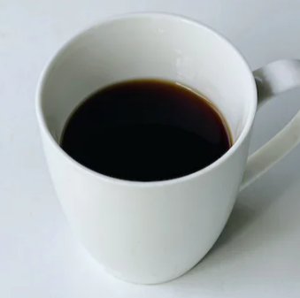
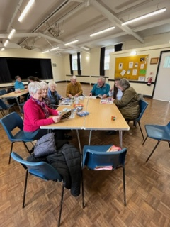
The 4 C’s Craft, Coffee, Cake & Chatter 3rd Friday of each month Badwell Ash Village Hall 10 till 12 There is a small charge for drinks, cakes, and items from the make and take table. Please do bring your own craft projects. For further information contact Sue Morgan 01359 258983
We would love you to join us for coffee or craft. Any surplus funds made will be donated to the designated charities below

